Slide 1
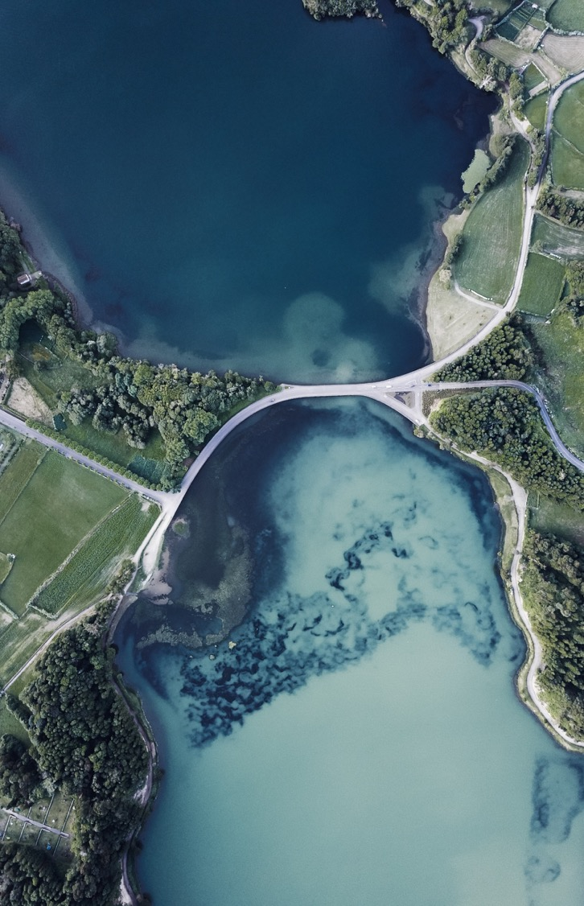
Business Opening Analysis in Miami Beach, Florida
Eric Collins

Slide 2
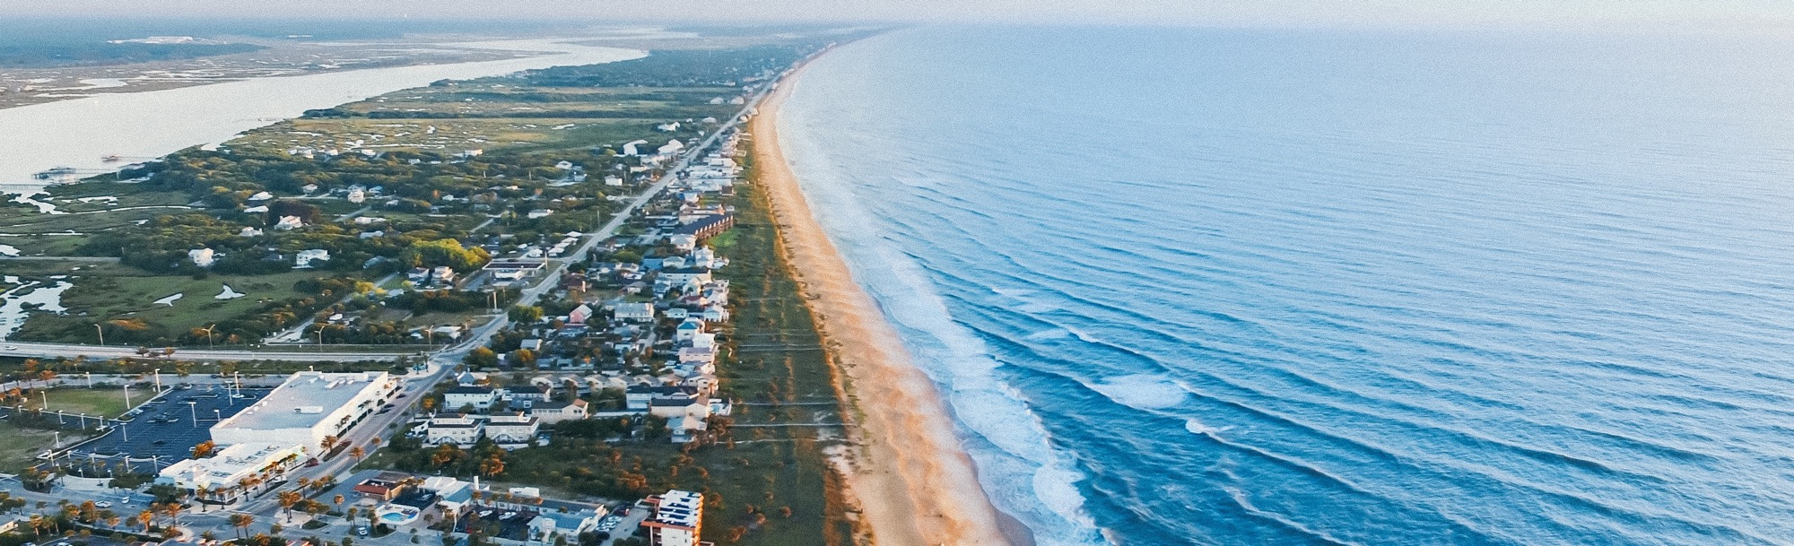
The question
Should I open a coffeehouse, small batch brewery, or small batch distillery in Miami Beach? If so, where?
Your company name

Slide 3


Data

Slide 4
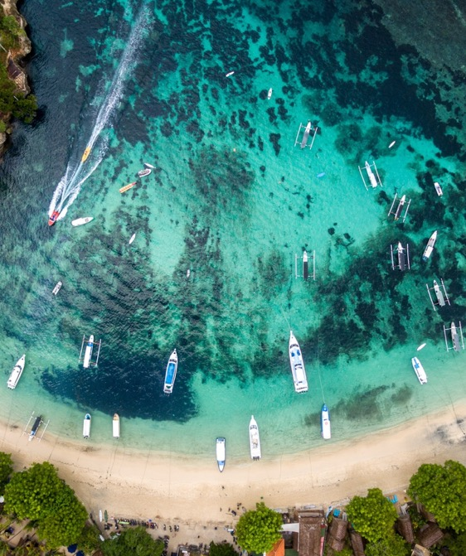
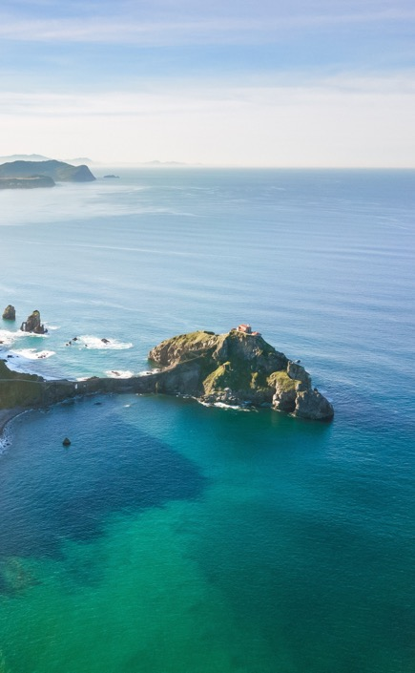
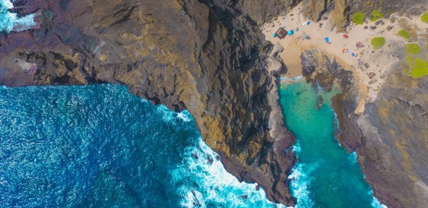
Methods
Count what kinds of business are trending through the FourSquare API.
See where the businesses are trending.
Determine what the investors should do.

Slide 5
Failure
There were no trending businesses!
RETHINK
REPHRASE THE QUESTION
Instead of counting trending business, count the types of individual businesses!
See what business are most popular by category and see where the market might be missing.
Your company name

Slide 6
SUCCESS!
There are far more Starbucks than anything else!
Coffee Shop Opening
Brewery/Distillery Opening
Open a high-end coffee shop on Bella Isle.
This will be the fastest and most robust ROI
Open a brewery or distillery to increase the diversity of the city.
This will be a lower ROI, but higher impact on the city overall.

Slide 7

https://github.com/eric-collins/Coursera_Capstone

